Slide 1
Human Genome Project
Student’s Name
Institutional Affiliation

Slide 2
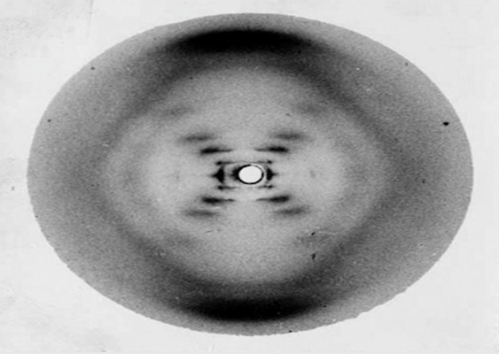
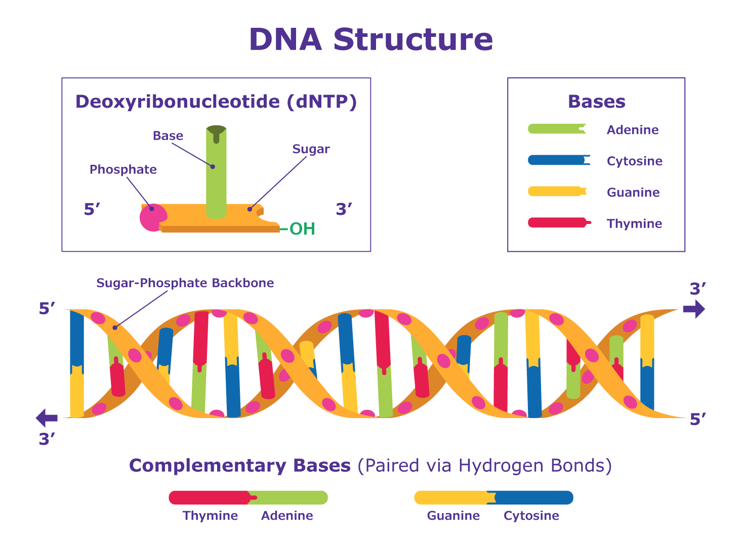
Five most important points in the history of the genome.
The history of the genome can be traced from Gregor Mendel's experiments about plant hybridization in 1865; In his experiment, he uses the monastery garden to cross pea varieties with different colors, heights, flower positions, and seed shapes; The experiments demonstrated how traits are passed from parents (NIH, n.d).
Another significant historical development of the genome is a photo by Rosalind Franklin indicating different patterns of the helical shape of DNA; She took two sets of high-resolution photos of crystallized fibers and examined their DNA strands.
In 1977, Frederick Sanger developed a DNA sequencing technique for determining the order of bases in DNA strands; The technique explained how DNA fragments of different lengths are separated.
The development of Cystic Fibrosis (CF) in 1989 was another significant development of the human genome (From Mendel to the Human Genome Project); Cystic Fibrosis is a genetic disease that causes sticky and thick mucus in the lungs, pancreas, and digestive tract (NIH, n.d).
In the early 1980s, several laboratory tools were used to find the gene responsible. In 1990, the human genome project started after the US Department of Energy and the National Institute of Health developed a plan to create a technology to analyze DNA (NIH, n.d).

Slide 3
Potential future benefits of the Human Genome Project and the risks associated with it.
The DNA-based tests can be used in disease diagnosis, confirm the existence of the disease, and offer prognostic information on the course of the disease.
The Human Genome Project will help researcher’s correlate DNA variants using individual responses on medical treatments and develop customized drugs.
Genomic data will help to develop drugs faster, more effective, and cheap.
On the other hand, the Human Genome project will result in social and ethical issues: There will be uncertainties on gene tests in complex conditions like diabetes and heart disease.
There will be a contradiction on whether testing will be performed without treatment or with unsure interpretation.
The project will lead to significant questions on individuals who should access personal genetic information, including insurers, schools, and employers, of agencies.
Many people are worried about whether patenting DNA sequences will limit their development and accessibility to useful products.

Slide 4
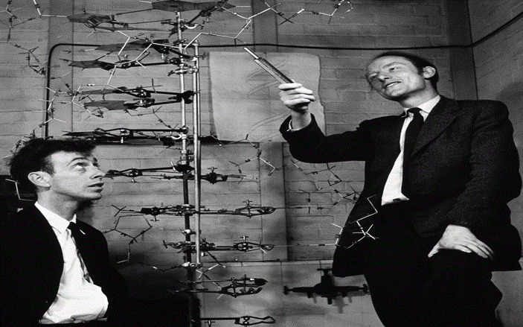
Conflict among scientists during the discovery of the structure of DNA.
There were four scientists involved in the development of DNA structure in 1953: Francis Crick, James Watson, Maurice Wilkins, and Rosalind Franklin.
None of the four scientists was wrong, but they engaged in competition and cooperation; For example, to develop the model building, Watson and Crick required data on DNA as a starting point.
Watson and click focused on creating new hypotheses while Franklin and Wilkin gathered additional evidence on DNA structure; From the beginning, Wilkins and Franklin argued about who was the most appropriate person to work on the DNA.
Scientists should be friends to share their ideas and help others achieve their goals.
They should work together to make a discovery.
If the four scientists had no conflicting options, the discovery of DNA structure could have been discovered earlier before 1953.
Although scientists usually have different options regarding who is best, working together and becoming friends can help them achieve more, appreciate other work, and make corrections when necessary.

Slide 5
What kind of tension exists in the cooperation of scientists and the commercial pressures for patents?
The project could not have been completed without the cooperation of different scientists, particularly from the United States and the United Kingdom.
The scientist had to help each other since it was a long project that required them to understand the human body and the negative impacts of drugs.
In the entire project, every scientist had different tasks to perform, and thus the tension could arise if they did not the required standards.
Additionally, the use of new technological tools was problematic to some scientists, and thus they had to develop new ways of using them (Yourgenome,2014).
The project allowed scientists to read and understand the entire genetic blueprint on the development of human beings.
The team members were motivated and had common goals in contributing to the most historical and organized scientific adventures.

Slide 6
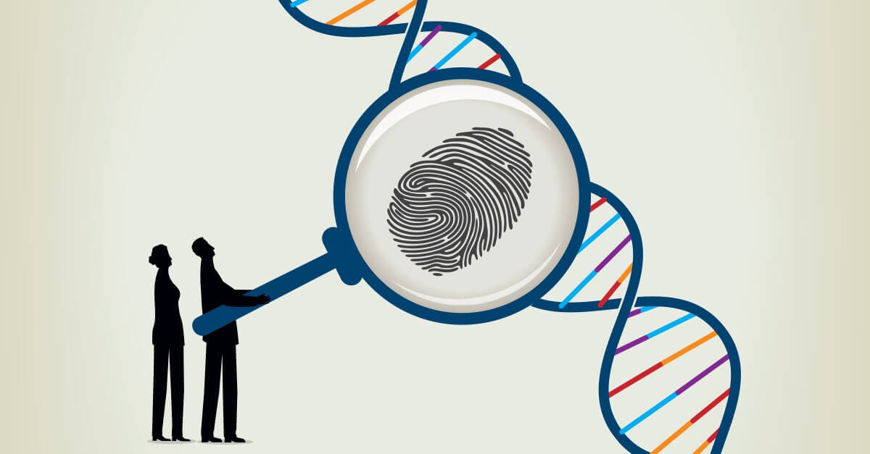

Will the discoveries of the Human Genome Project benefit us?
Some of the potential applications of genome research include DNA forensics, molecular medicine, anthropology, bio archaeology, and bioprocessing.
In molecular medicine, clinicians can improve disease diagnosis, detect earlier symptoms of genetic predispositions, conduct gene therapy, and control drugs systems.
Additionally, the resources and technology applied in the project have already started to show some positive impacts in clinical medicine and biological research.
The project promotes medical advancement in the treatment and diagnosis of diseases like cancer.
Notably, cancer is a genomic disease, and with the application of this project, doctors can successfully categorize the different types of cancers by examining genomic changes within the individual tumor.
Moreover, genomic findings guide physicians for common diseases; For instance, a blood thinner can be prescribed to prevent platelets from binding ineffectively.

Slide 7
References
NIH (n.d). A Brief History from Mendel to the Human Genome Project. https://www.unlockinglifescode.org/timeline?tid=4
Yourgenome (2014). The Human Genome Project: Personal Stories. https://www.youtube.com/watch?v=BQQEX8rU2tY
https://www.thinkib.net/files/biology/files/activity%20worksheets/genetics/primer11_human_genome_project.pdf

